Slide 1
Communicating in a time of Narrative Change
A presentation prepared by Melissa Johnson Hewitt, MSW

Slide 2
What is Narrative?
Narrative is…
A story or account of events, experiences, or the like, whether true or fictitious
Patterns or systems of stories
Story – a description of people and events
Narrative – an account of a series of events
Deep Narrative – pervasive and intractable

Slide 3
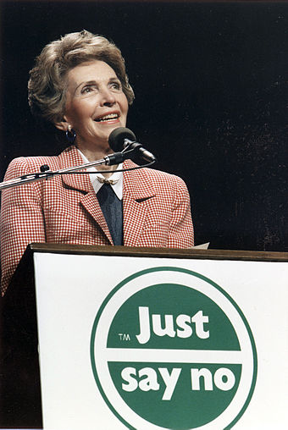
WAR ON DRUGS

Slide 4
Why does narrative matter?
Narrative …
Is particularly important in social movements
Fuels deep perception
Has ”baked-in” assumptions/values about all sorts of diversity, often with racial stereotypes and bias
Is a default starting point for all conversation, planning, action, and even research
Does not have to be true!
Influences how people think, feel, and act about issues

Slide 5
Why is narrative important to consider in nonprofit communications?
Primary purpose of Communications
Inform/Educate audience about your organization
Demonstrate progress and impact
Make the case for collaboration or support

Slide 6
Why is narrative important to consider in nonprofit communications?
Secondary Purpose of Communications
Shift from one narrative to another narrative
Shift narrative in order to:
expand audience
deepen work
appeal to a broader donor pool
work towards policy change
Narrative Change is often used as a strategy to build power and shape conversation around an organization’s work

Slide 7
Narrative and Social Movements
Communications
Research
Message Framing
Creative Engagement
Critical Questions:
What does the research tell us?
What is the theory of change?
What and who do you want to shift? Why?
Whose point of view is being centered?

Slide 8
Race Forward, along with partner orgs, led the DTIW Campaign to help eliminate the use of the word “illegal” when referring to undocumented immigrants.
Research
Increase in hate crimes against immigrants
Immigrants and refugees under attach by US systems
Media, journalists, researches were elevating risk by continuing to use the I-word
Are most immigrants and refugees in the US illegally?
Message Framing
It’s dehumanizing
It’s racially charged
It’s legally inaccurate (and confuses the debate)

Slide 9
The efforts of the 2010 campaign focused on specifically targeting news outlets & journalist associations, putting pressure on them to Drop the I-Word.
As a result, major news outlets like Associated Press, USA Today, and the Los Angeles Times pledged to drop the word from their reporting.
After the word was removed from the Associated Press(AP)Style Guide in 2013, there was a drastic decrease in the word’s use.

Slide 10
RESOURCES
RACE FORWARD
https://www.raceforward.org
NARRATIVE INITIATIVE
https://narrativeinitiative.org
OPPORTUNITY AGENDA
https://www.opportunityagenda.org/approach/communications-culture-narrative-change
FRAMEWORKS INSTITUTE
https://www.frameworksinstitute.org

Slide 11
THANK YOU!

